Slide 1


Overview of machine learning projects in Finance Division
Oleg Mitsik
Lead Data Scientist, Finance Division, Sberbank
Mitsik.O.M@Sberbank.ru

Slide 2
Functions of Finance Division
Board / ALCO
Regulator
Management decisions and reporting
Strategic decision-making support
Management by objectives
ALM and tax risk management
Finance
Division
Regulatory reporting
Compliance with risk-norms
Contribution to lawmaking process
Business
Investors
Operational decisions and reporting
Transactions with clients
Project activity
Procurement control
Information disclosure
Listing on exchanges
Financial markets
Financial markets transactions
Educational services

Slide 3



Key areas of ML application
Decision-making Automation
Recommender Systems
Natural Language Processing
Predictive analytics tools
Making strategic decisions
faster and more accurate
AI for self-service
Automation of operational decisions to ↓ time to decision and ↑ operational efficiency
Optimization of internal
business-processes
Increasing efficiency of
the financial function
Improved business-processes:
Strategy and business planning
Interest rate and tariff management
Balance sheet structure management
ALM risks and liquidity management
Capital adequacy management
Pricing of product lines and individual transactions
Assessment of projects and operations efficiency
Chatbots in self-service information systems
Transfer pricing
Identification and optimization of redundant expenses
Accounting analytics
Tax planning

Slide 4
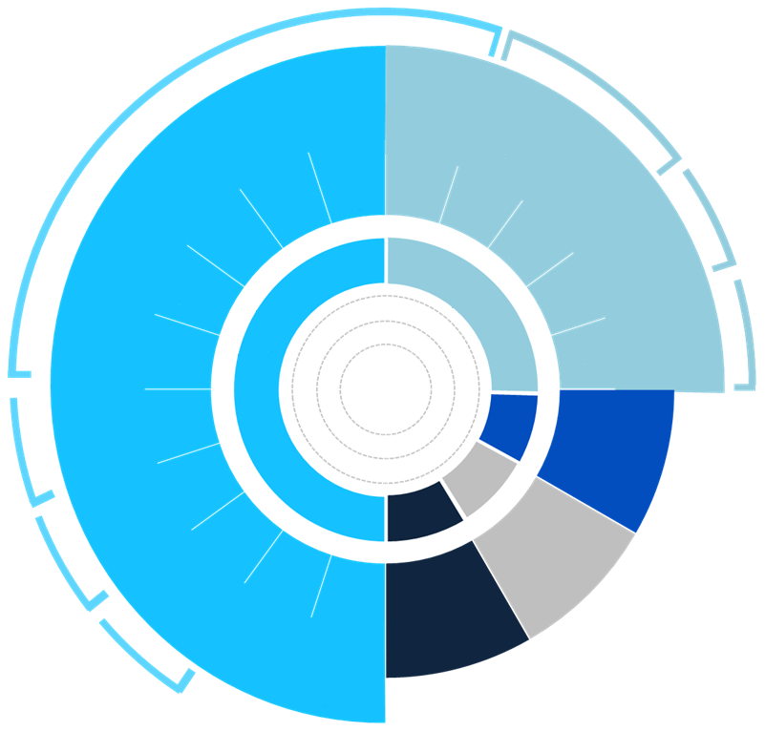
Overview of current projects
«Dynamic Balance» platform
Holistic model and optimization of bank’s balance sheet and P&L
Forecasting of key markets
Estimation of product line elasticities and construction of Value Driver Tree
Business planning and analysis of business unit operations
SMART-scenarios and FTP2.0
Balance sheet structure management
Crowd-forecasting for balance sheet items
Planning and forecasting
Transfer pricing
AS Navigator
Identification of redundant expenses and optimization of warehouse supplies
Chatbot for SAP ERP users support
Structural liquidity management
Management reporting
Behavioral model of largest clients
Extraction of stable components in largest client accounts
Duration and confidence interval of the derived stable components can be specified
Capital adequacy management
Quality of financial control
Capital adequacy forecasting
Treasury Finance Dept.
Interest and currency risk management
Project evaluation
Currency reserve hedging and revaluation of available for sale portfolio
Property valuation
Capital markets operations
AR
Accounting and reporting
Департамент учета и отчетности
«SPREAD» – commercial paper (CP) placement assistant
Identification of high demand periods
Reduction of the spread between bank's CPs and government bonds
Short-term liquidity and cash management
TP
Accounting analytics
IR
Управление налогового планирования
Daily forecasting of «unguaranteed» payments through nostro account
Pricing and interaction with business blocks
Tax
planning
Investor relations
International network activities
Investor Relations
Relations with CB and Basel
Forecasting of tax liabilities and effective tax rate
Tax risk management automation
«Deep Calculations» platform
Holistic pricing of credit with account for x-sale opportunities
Dynamic pricing of corporate deposits driven by liquidity requirements
Predictive analytics tools
AI for self-service
Optimization of internal business-processes

Slide 5
Dynamic pricing of corporate deposits with deep reinforcement learning

Slide 6






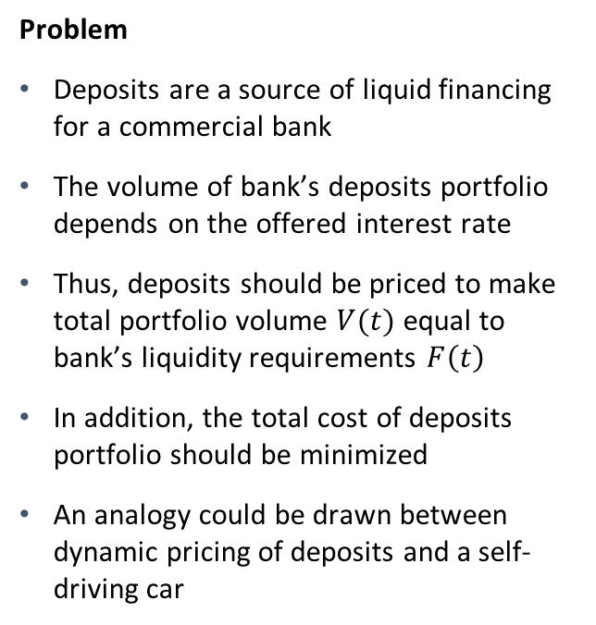
Deposits pricing as an analogy to a self-driving car
Problem
Deposits are a source of liquid financing for a commercial bank
The volume of bank’s deposits portfolio depends on the offered interest rate
Thus, deposits should be priced to make total portfolio volume $V(t)$ equal to bank’s liquidity requirements $F\left(t\right)$
In addition, the total cost of deposits portfolio should be minimized
An analogy could be drawn between dynamic pricing of deposits and a self-driving car
Analogy to a self-driving car
$$F(t)$$
Liquidity requirements
Road
0
weeks
$$r$$
Interest rate curve
Steering wheel and pedals
0
weeks
Interest expense
Fuel consumption

Slide 7




Trade-off between short-term and long-term deposits
Strategy 1 – short-term deposits
Amount of funds equal to $F\left(t\right)$ can be raised by taking a new portfolio of short-term deposits every period $t$
Short-term deposits are cheaper, but mature quick and so have to be rolled over
$V(t)$, $F(t)$
Strategy 2 – long-term deposits
Another strategy is to initially take such long-term deposits that will certainly meet all expected liquidity needs $F\left(t\right)$
Long-term deposits are more expensive
Excessive funds can be reinvested through money market
$$V(t)\text{,} F(t)$$
0
1
2
3
weeks
0
1
2
3
weeks
Optimal strategy
Optimal strategy that minimizes total cost of portfolio while fulfilling liquidity constraints is some superposition of strategy 1 and strategy 2
Relative weights of two strategies depend on market conditions
$$V(t)\text{,} F(t)$$
0
1
2
3
weeks

Slide 8
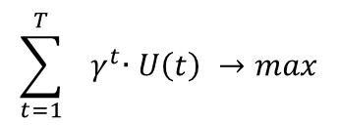

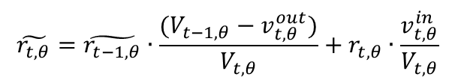

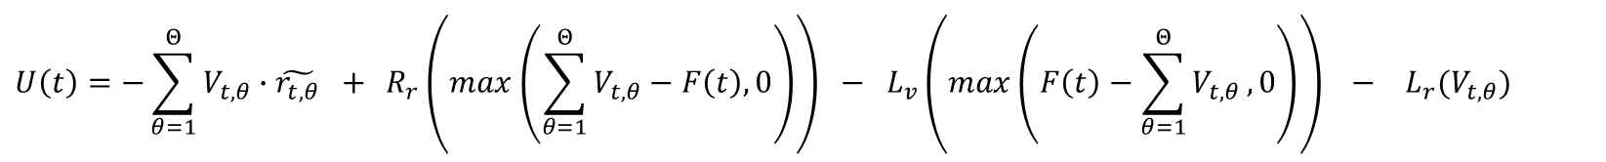
Pricing of deposits as an optimal control problem
Optimal control problem setup for managing portfolio of deposits with maturity terms$θ∈\left\{θ_{i}\right\}$ during a $T$–day period
Discounted financial result for day t
Interest rate constraints based on the model applicability range
$$\sum_{t=1}^{T}{{ γ}^{t}∙U\left(t\right) →max}$$
$$r_{t,θ}∈{[r}_{lower bound}, r_{upper bound}], \left|r_{t,θ}−r_{t−1,θ}\right|≤r_{delta bound}$$
Interest expense
Reinvestment income due to excess liquidity
Borrowing cost due to liquidity shortage
Risk-norm constraints
$$U\left(t\right)=−\sum_{θ=1}^{Θ}{V_{t,θ}∙\tilde{r_{t, θ}} + }R_{r}\left(max\left(\sum_{θ=1}^{Θ}{V_{t,θ}−F\left(t\right),0}\right)\right) − L_{v}\left(max\left(F\left(t\right)−\sum_{θ=1}^{Θ}{V_{t,θ}},0\right)\right) − L_{r}(V_{t,θ})$$
Deposits daily addition volume
Dynamics of portfolio volume
Dynamics of portfolio weighted-average interest rate
$$\tilde{r_{t, θ}}=\tilde{r_{t−1, θ}}∙\frac{{(V}_{t−1,θ} − v_{t,θ}^{out})}{V_{t,θ}}+r_{t, θ}∙\frac{v_{t,θ}^{in}}{V_{t,θ}}$$
$$v_{t, θ}^{in}=f_{θ}^{elasticity}(r_{t, θ},…)$$
$$V_{t,θ}=V_{t−1,θ}−v_{t,θ}^{out}+v_{t,θ}^{in}$$

Slide 9

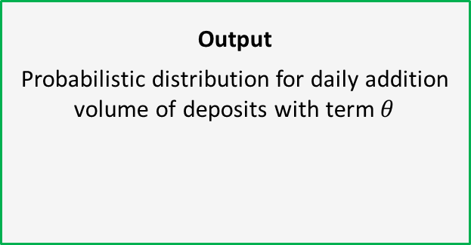
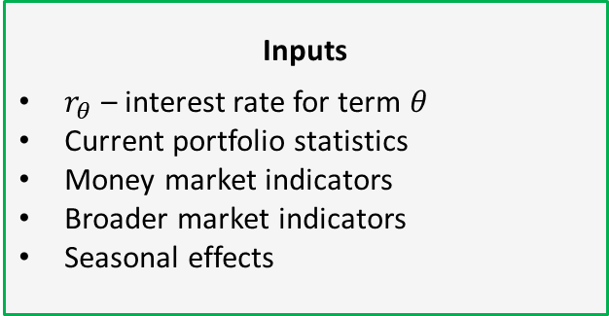

Elasticity model of deposits daily addition volume
Inputs
$r_{θ}$ – interest rate for term $θ$
Current portfolio statistics
Money market indicators
Broader market indicators
Seasonal effects
Output
Probabilistic distribution for daily addition volume of deposits with term$θ$
Gaussian Process
$$v_{θ}^{in}$$
Current portfolio statistics:
Portfolio size
Matured volume
Amount of embedded options
Money market indicators:
Central Bank auctions
Tax calendar
Federal Treasury balance
Monetary base
Finance Ministry interventions
Broader market indicators:
FX rates
Oil and natural gas prices
Gold price
Stock market indices
Bond market indices
Volatility indices
Seasonal effects:
Monthly
Weekly (ends of quarters)
Daily (near weekends and public holidays)

Slide 10
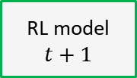
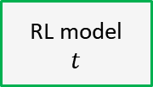
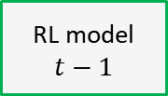




Looking for right pricing with deep deterministic policy gradient
Base reinforcement learning model architecture
Stacking of base models through time
Policy network
Input layer
RL model
$$t−1$$
Dense layer
3x
Parametric ReLU
Portfolio
$$t−1$$
Q-values
$$t$$
Current portfolio
Dense layer
Tanh
RL model
$$t$$
Future liquidity requirements
Interest rate curve
Q-values
Portfolio
$$t$$
Q-values
$$t+1$$
Q-network
Input layer
RL model
$$t+1$$
Dense layer
3x
Parametric ReLU
Dense layer
Exploration process is done according to a truncated normal distribution with shrinking variance

Slide 11
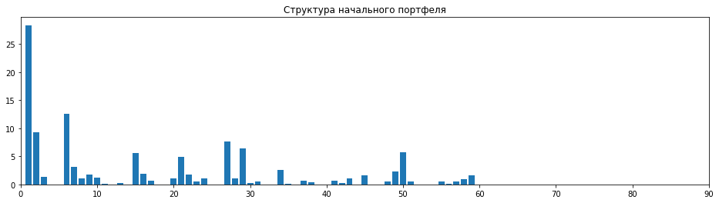

An example of corporate deposits pricing (1 out of 2)
Lets consider the problem of pricing short-term ruble-denominated large corporate client deposits on a daily basis
Terms of new deposits are split into 6 buckets of roughly same size for simplification
What should be interest rate curve as of the pricing date (7th June 2018) given the expected liquidity requirements of the bank?
What is expected portfolio volume and structure given this pricing?
Term buckets of deposits
1D | 1 day
1W | 2 days – 1 week
2W | 1 week – 2 weeks
1M | 2 weeks – 1 month
2M | 1 month – 2 months
3M | 2 months – 3 months
Initial portfolio structure (6th June 2018)
RUB bn

Slide 12
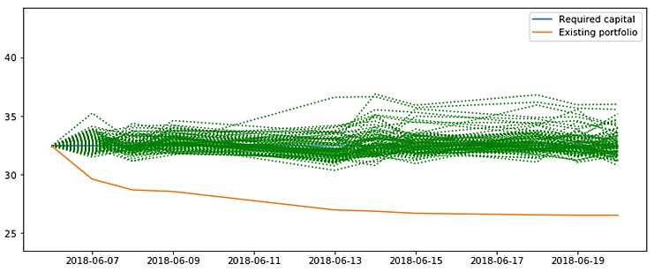
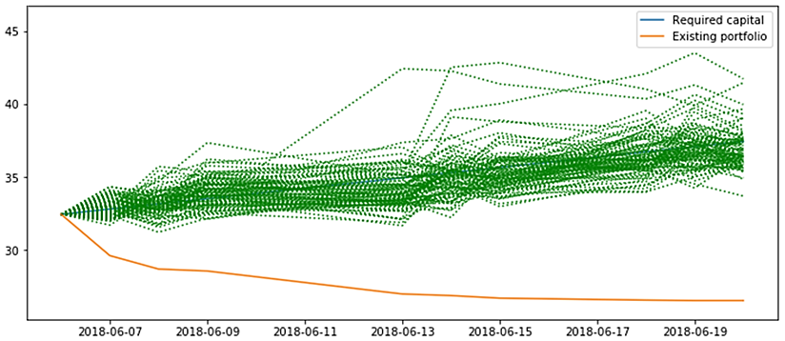
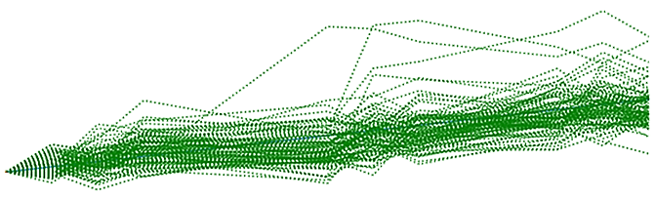

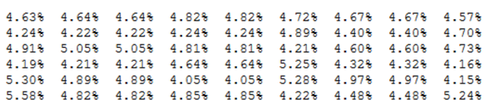
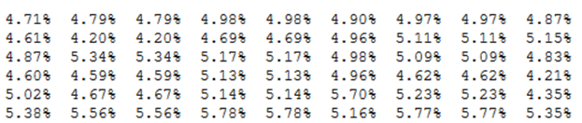
An example of corporate deposits pricing (2 out of 2)
Goal → maintain the same portfolio volume during 2 weeks
Goal → raise new funding of 50 RUB bn during 2 weeks
Simulated portfolio volumes under optimal pricing policy
Simulated portfolio volumes under optimal pricing policy
RUB bn
450
400
350
300
RUB bn
400
350
300
250
Average daily interest rate curves
Average daily interest rate curves
Jun-7 Jun-8 Jun-9 Jun-13 Jun-14 Jun-15 Jun-18 Jun-19 Jun-20
Jun-7 Jun-8 Jun-9 Jun-13 Jun-14 Jun-15 Jun-18 Jun-19 Jun-20
1D:
1W:
2W:
1M:
2M:
3M:
1D:
1W:
2W:
1M:
2M:
3M:

Slide 13
Conclusion
Key takeaways from the presented method:
Approaching pricing of deposits as an optimal control problem lets simultaneously answer two questions: «what is the right pricing policy?» and «what is expected portfolio dynamics under this pricing policy?»
Even though daily deposits addition volumes may have significant component of unpredictability, optimal control can absorb unexpected fluctuations by adjusting next day’s interest rate curve
This fact makes an impact on today’s pricing as optimal control can reduce portfolio variance on the planning horizon
Calculation of new pricing trajectories happens instantaneously, as the reinforcement learning model has already learnt optimal policies for various liquidity requirements
The implemented model can also calculate bank’s expected financial result based on the actually observed portfolio trajectory

Slide 14
Thank you!

